Slide 1
Pizzilla Part 3
AIS Tech Talk

Slide 2
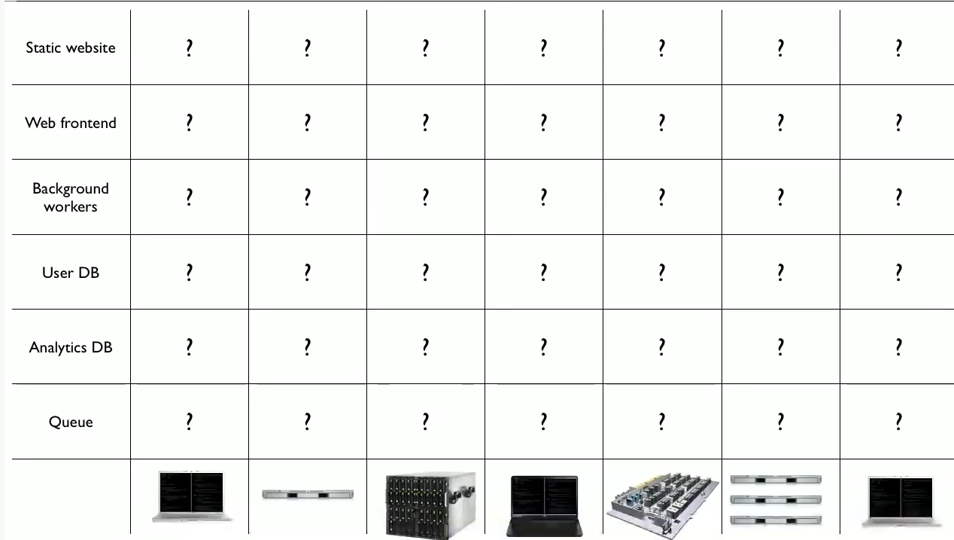
The Problem

Slide 3
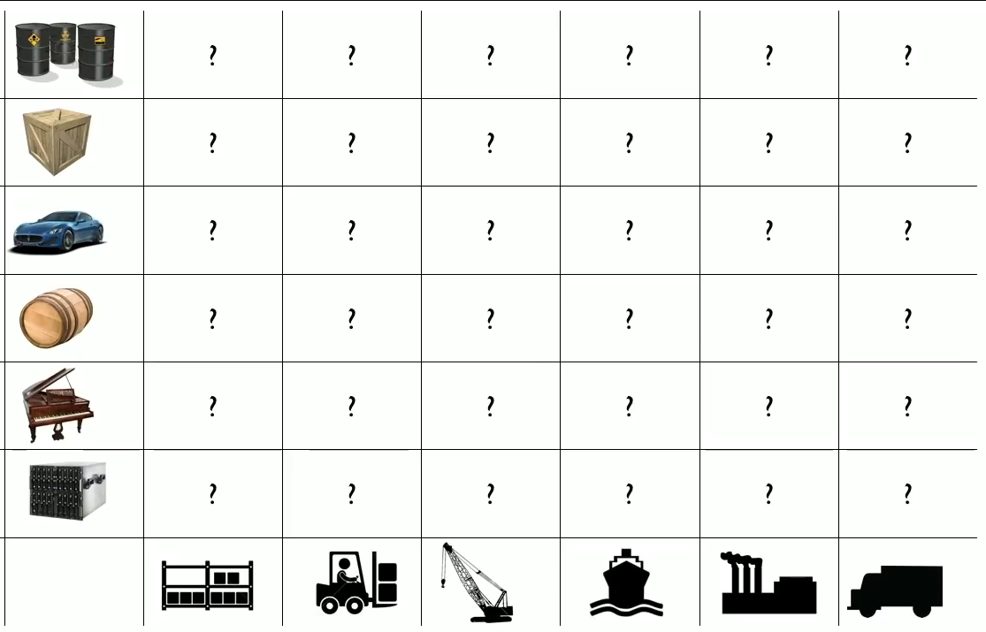
The Shipping Industry

Slide 4
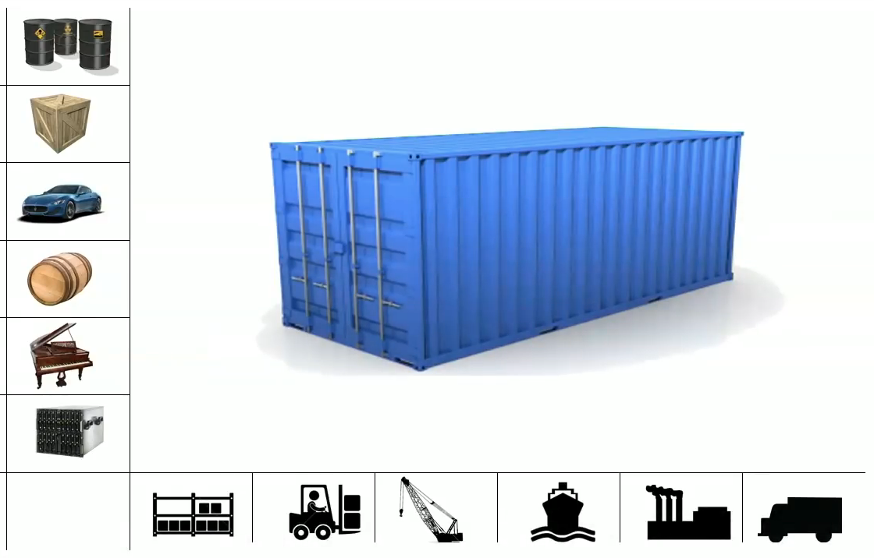
The Solution

Slide 5
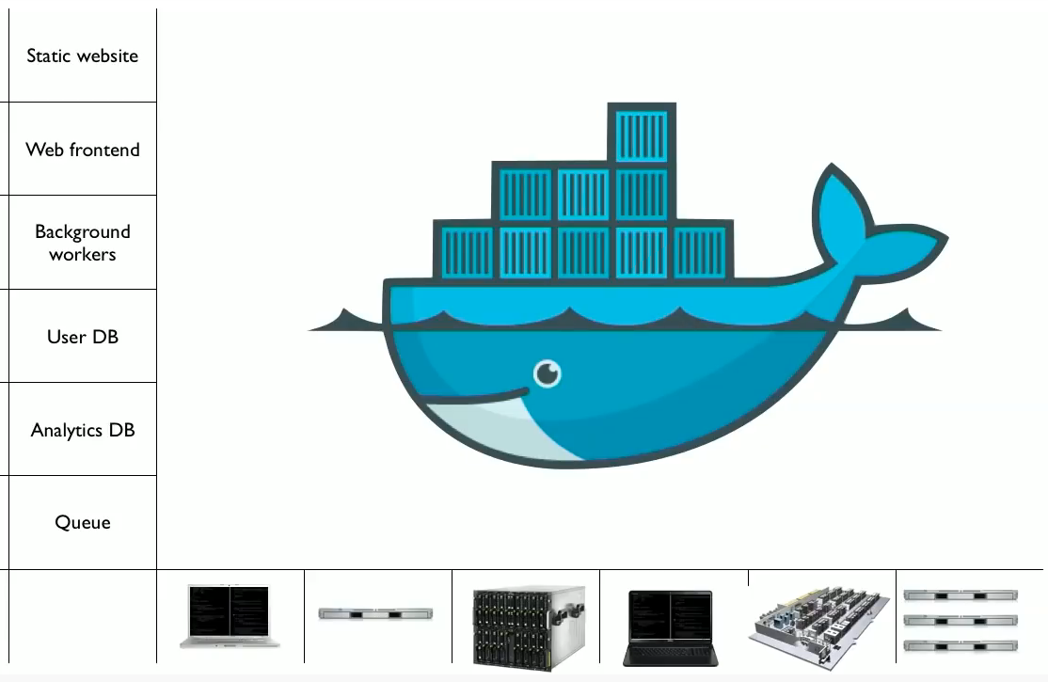
Docker

Slide 6
What is Docker?

Slide 8
Kubernetes
Container Orchestration System
Basically helps you manage deployment and scaling of a group of containers
Open source
Created by Google

Slide 9
Deploying your Application
AWS
ECS (Elastic Container Service)
EKS (Elastic Kubernetes Service)
ECR (Elastic Container Registry)
Notes:
I spent a long time trying to way I could package up the material to
ECS is a container orchestrator
ECS is AWS’ response to Kubernetes

Slide 10
Elastic Container Service
Clusters
Instances
Services
Tasks
Containers
Cluster
Instance
Instance
Task 1
Task 1
Container
Container
Container
Container
Container
Container
Service
Task 2
Task 2
Container
Container
Container
Container
Container
Container
Service

Slide 11
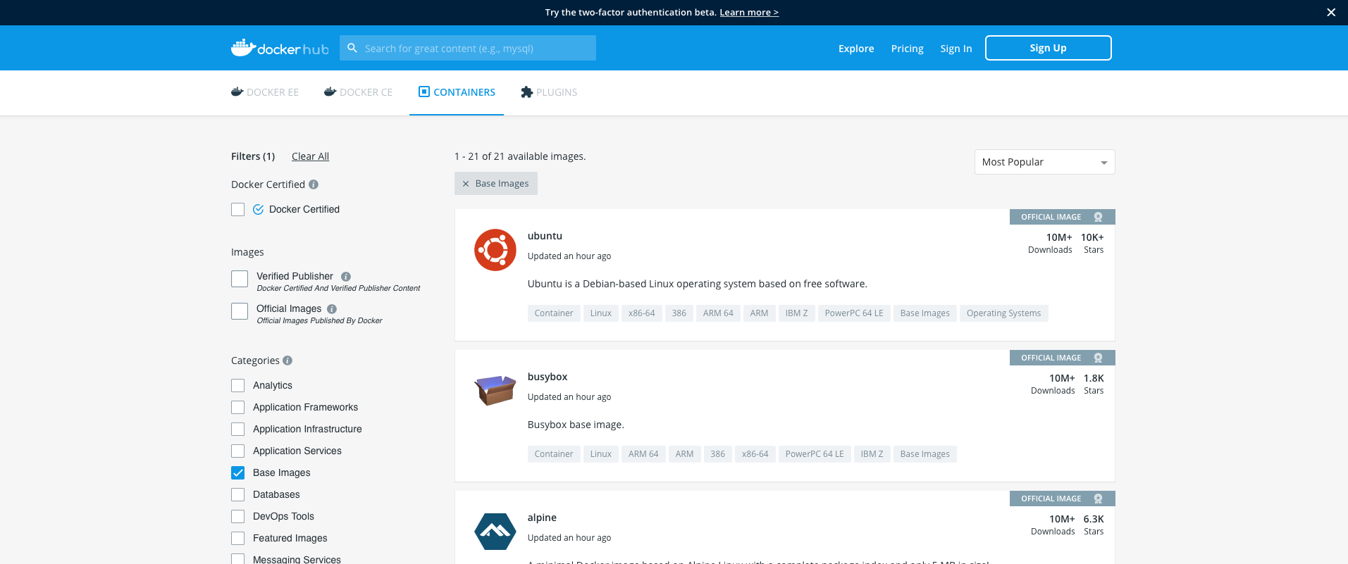
DockerHub

Slide 12
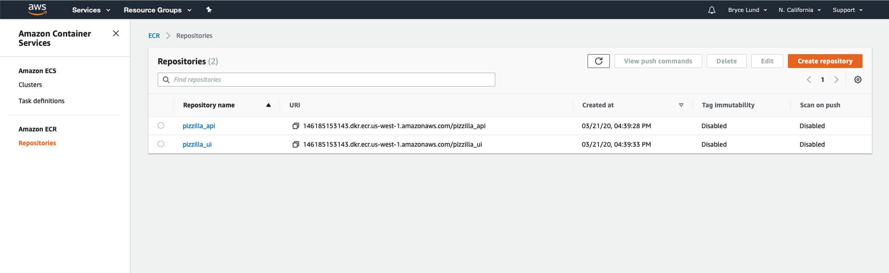
Elastic Container Registry
Notes:
Requires AWS Command Line Interface

Slide 13
Optional Install Steps
Google Installing the AWS CLI
Google Installing the Amazon ECS CLI
Steps (roughly):
Install CLI tools
Create IAM user for programmatic access
Save keys
Add keys to cli when you login

Slide 14
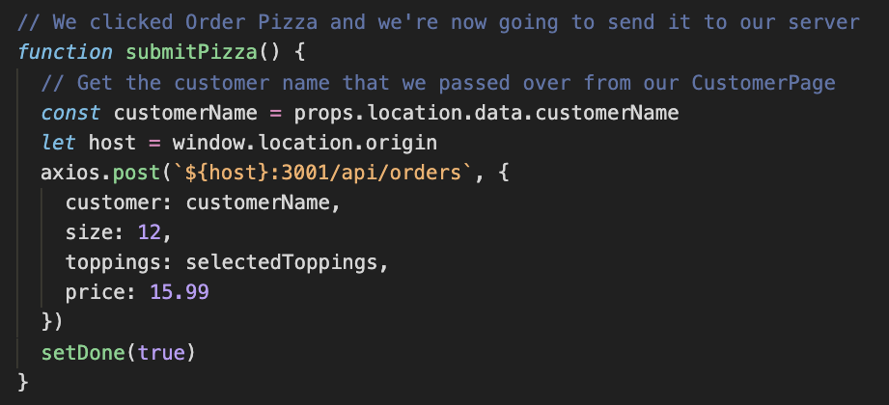
Code Changes

Slide 15
Code Changes
http://somedomain.com/api/orders
host = http://somedomain.com
http://somedomain.com:3001/api/orders

Slide 16
Dockerfile
Create two files called “Dockerfile”
One in the api folder
One in the pizzilla-react folder
Used as instructions for Docker as how to build your container image

Slide 17
Dockerfile
FROM node:10
Use Node.js version 10 as a starting point
WORKDIR /usr/src/app
Inside the container, all the app code will be at /usr/src/app
COPY . .
Copy all the app code into the work directory
RUN npm install
Tell docker to run npm install to get your node_modules folder

Slide 18
Dockerfile
VOLUME /usr/src/app
Set usr/src/app as the main volume for the container
EXPOSE 3000
Let port 3000 (where our react project runs) be shown outside of our container
CMD [ "npm", "start" ]
Tell docker what commands are used to start up our container.

Slide 19
.dockerignore
What files should we not copy into our docker container?
Create a .dockerignore file in the root directory of each container (api and pizzilla-react)
Works just like .gitignore

